Slide 1







Simplifying Banking Decisions with Business Decision Intelligence
From complex analytics to confident actions
Risk vs
Return
Growth vs
Capital
BDI
BENEFITS
EFFORTLESS DECISIONS
Streamline preparation
CONFIDENCE & CONSISTENCY
Improve Decision quality
SEAMLESS INTEGRATION
Fits existing workflows
MAXIMIZE VALUE
Leverage current analytics
Pricing vs
Competitiveness
Relationships vs
Limits
THE CHALLENGE
Banks Have analytics
They Struggle to balance complex trade-offs before a decisions
OUR SOLUTION
BDI brings Moody’s intelligence into client’s decision context
Banks make confident decisions easier
ORIGINATION
STRUCTURING
CREDIT COMMITEE
PORTFOLIO
STRATEGY & PLANNING
Should we pursue ?
How to structure ?
Do we approve ?
What to monitor ?
Where to grow?

Slide 2
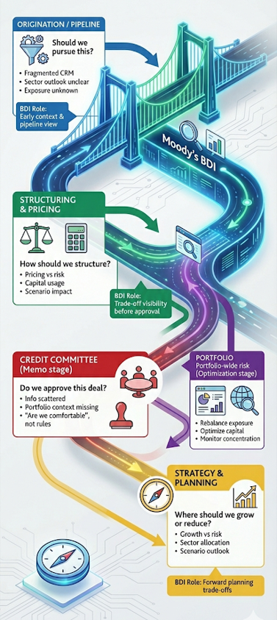
Where real banking decisions happen
When we talk to banks, most focus on improving one workflow like the credit memo.
But decisions actually happen across many forums.
Origination, structuring, portfolio management and credit committee are only part of the picture.
There are also ongoing portfolio, capital, and strategy decisions.
Moody’s already supports many of these moments today — through research, credit tools, and portfolio analytics.
BDI connects those perspectives so teams can make decisions with full context, not in silos

